Slide 1
The New Right
17th November 2009
WARNING!!! Family values are declining and this has put the family in crisis!!
Aim: TO be able to explain the new right approach to the study of family and family life

Slide 2
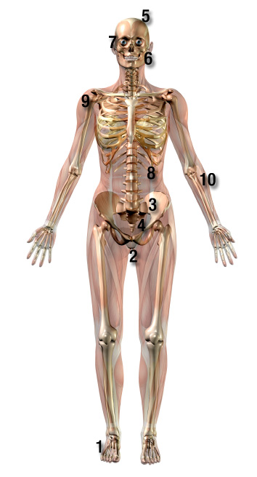
The New Right
WARNING!!! Family values are declining and this has put the family in crisis!!
This approach of the 1980’s and 1990’s can be seen as a more recent version of the functionalist approach
Remember: it believes that the nuclear family is the type of family that works best. Children brought up by both parents were thought to do better educationally, physically, psychologically and socially.

Slide 3
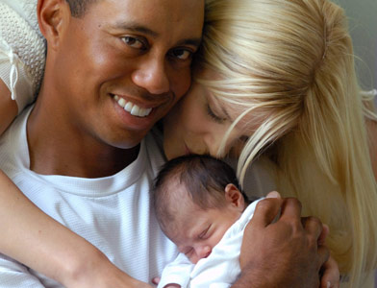
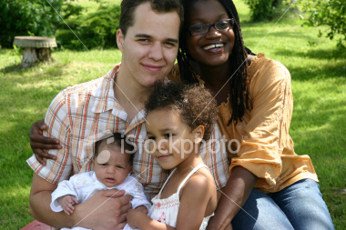
4 Aspects of Family Values
Family values are based on the view that there is a normal family type, made up of a married couple bringing up their own natural (that is biological) children

Slide 4


Supporters of family values believe that the women should be the carer and nurturer within the family, while the man should be the breadwinner (the one who goes out and works) and the protector

Slide 5
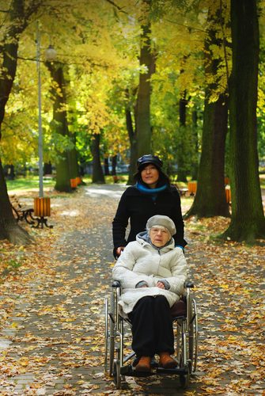
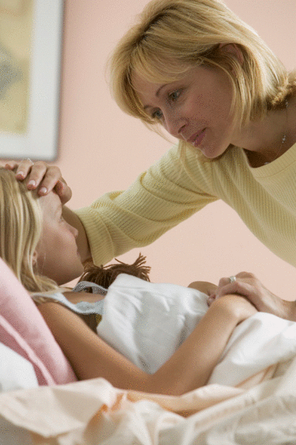
Family members have a duty to provide for each other and look after older, sick, unemployed or homeless members of the family

Slide 6


Supporters of family values tend to oppose gay and lesbian rights, sexual freedom, certain types of sex education and (especially in the USA) abortion

Slide 7
Discuss: Do you Agree?
The woman should be the carer within the family and the man should be the breadwinner
Family members have a duty to provide for each other and look after older, sick, unemployed or homeless family members

Slide 8

Challenge
How do you think supporters of family values might view:
An increase in divorce?
An increase in lone-parent families?
Mothers who work in full time paid employment?
Do you think supporters of family values want the welfare state (provisions of NHS and state benefits) to have a larger or a smaller role?

